Slide 1

NITTE MEENAKSHI INSTITUTE OF TECHNOLOGY DEPARTMENT OF INFORMATION SCIENCE AND ENGINEERING
SUBMITTED BY: FACULTY:
AKSHATA ANJUTAGI 1NT19IS401 Dr . Adithya shastRY
LAVANYA K 1NT19IS407 PROFESSOR AT ISE DEPT NMIT

Slide 2
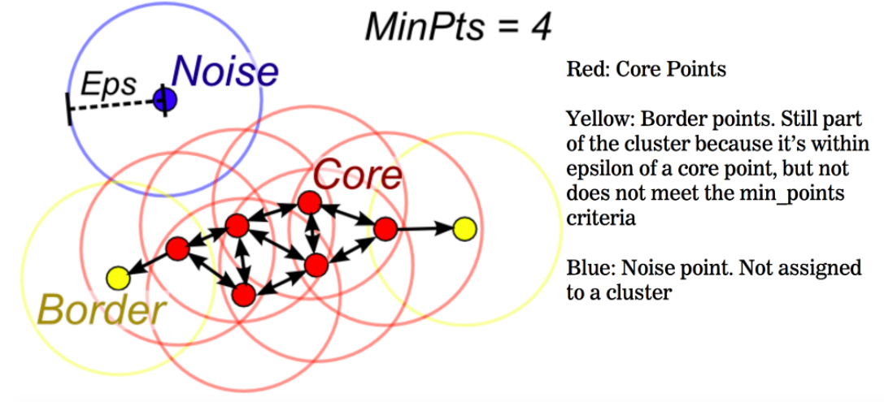
DBSCAN a data clustering algorithm. It is a density-based clustering non-parametric algorithm given a set of points in some space, it groups together points that are closely packed together.
DBSCAN CLUSTERING ALGORITHM

Slide 3

DBSCAN algorithm Components
1.Epsilon
2.MinPts
3. Core Point
4. Border Point
5. Noise or outlier

Slide 4
ABSTRACT ALGORITHM
The DBSCAN algorithm can be abstracted into the following steps:
Find the points in the ε (eps) neighborhood of every point, and identify the core points with more than minPts neighbors.
Find the connected components of core points on the neighbor graph, ignoring all non-core points.
Assign each non-core point to a nearby cluster if the cluster is an ε (eps) neighbor, otherwise assign it to noise.

Slide 5
ADVANTAGES AND DISADVANTAGES
ADVANTAGES
DISADVANTAGES
. It is not very effective when you have clusters of varying densities.
Not entirely deterministic.
If you have high dimensional data, the determining of the distance threshold Ɛ becomes a challenging task
It does not require a pre-set number of clusters.
It identifies outliers as noise, unlike the Mean-Shift method that forces such points into the cluster in spite of having different characteristics.
It finds arbitrarily shaped and sized clusters quite well.
Mostly insensitive to ordering of points in database

Slide 6
CODE
import matplotlib.pyplot as plt
from sklearn.datasets import make_moons
from sklearn.cluster import DBSCAN
%matplotlib inline
import warnings
warnings.filterwarnings("ignore")
x, label = make_moons(n_samples=200,noise=0 )
x[0:5]
label
model=DBSCAN(eps=0.25, min_samples=10)
model.fit(x)
model.labels_
fig, ax=plt.subplots(figsize=(6,5))
ax.scatter(x[:,0], x[:,1], c=model.labels_)
fig.show()
fig, ax=plt.subplots(figsize=(6,5))
ax.scatter(x[:,0], x[:,1], c=label)
fig.show()

Slide 7
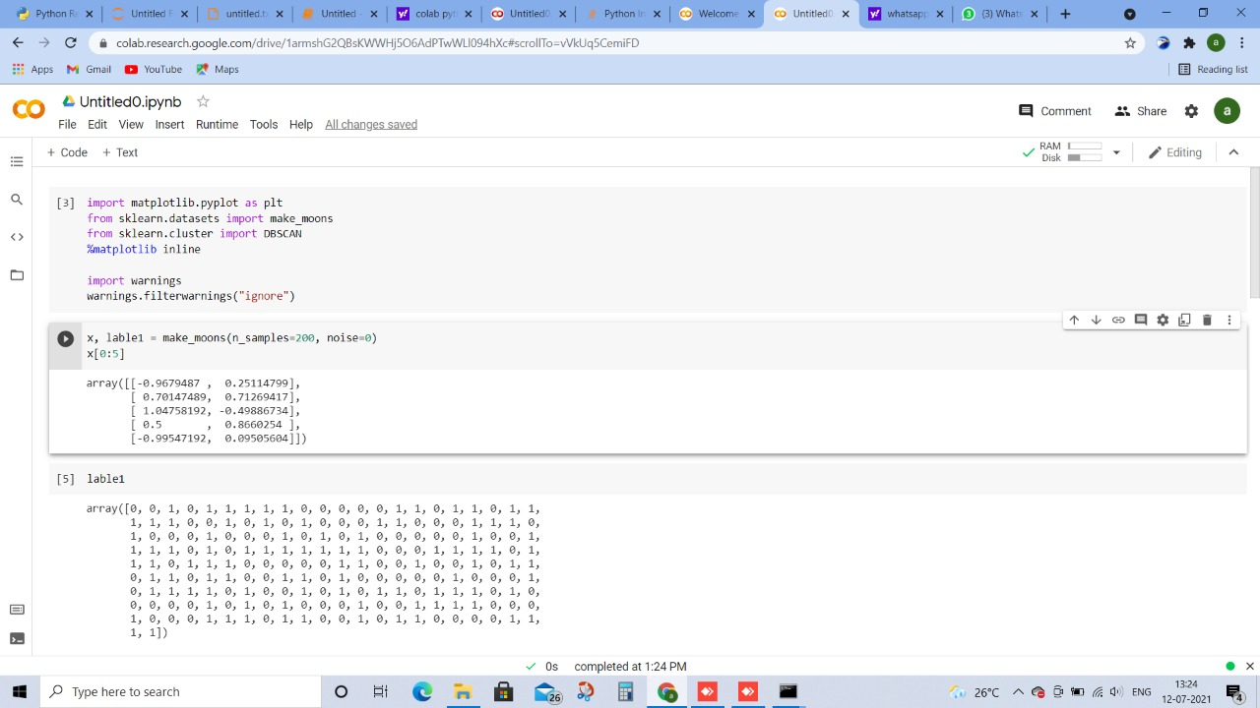

Slide 8
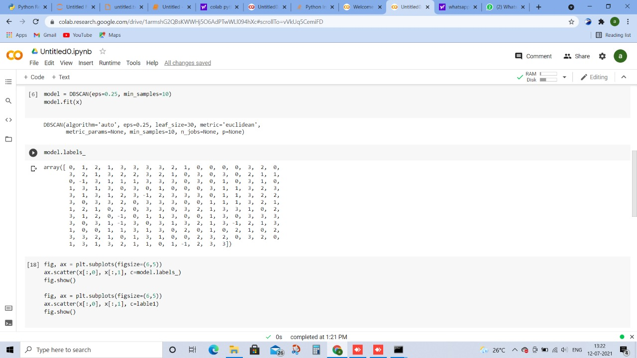

Slide 9
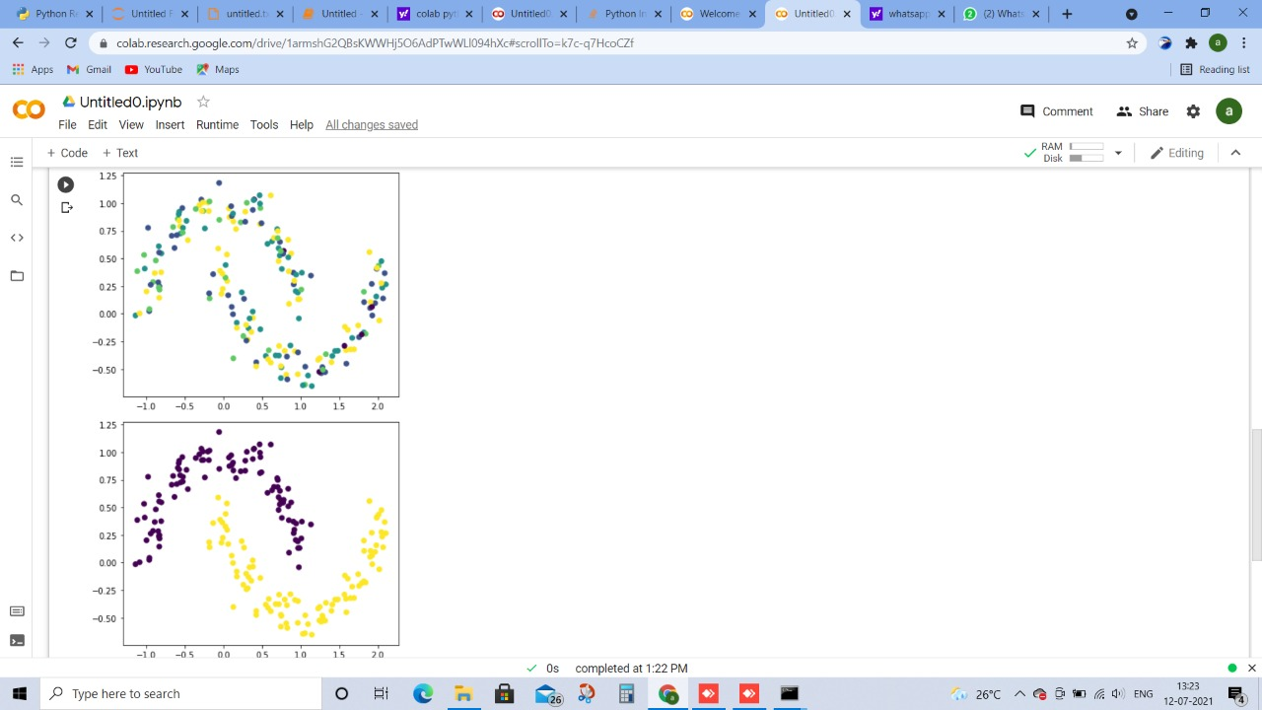

Slide 10


Slide 11
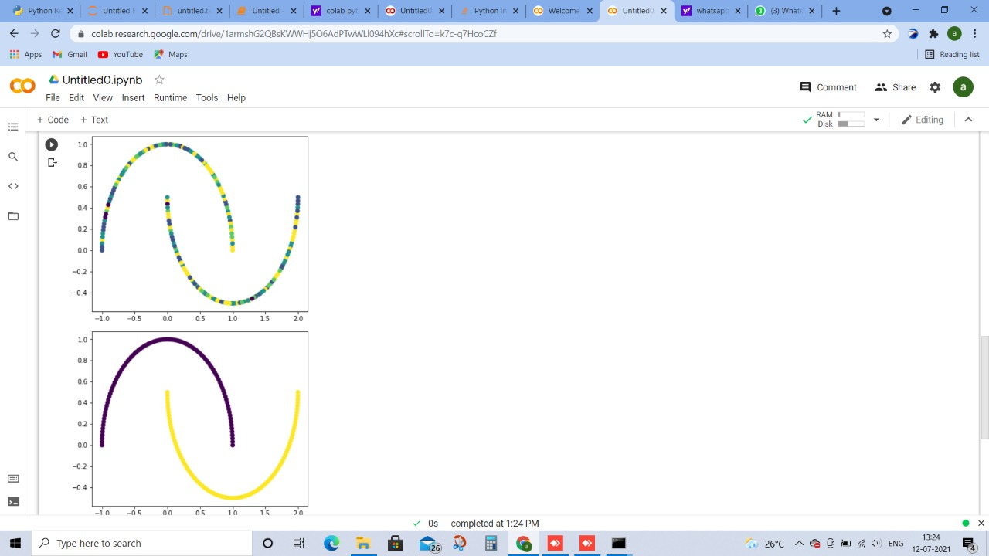

Slide 12
THANK YOU

